Slide 1


Analysis of
Social Buzz’s
Top 5 Categories

Slide 2


Today's agenda
Project recap
Problem
The Analytics team
Process
Insights
Summary

Slide 3

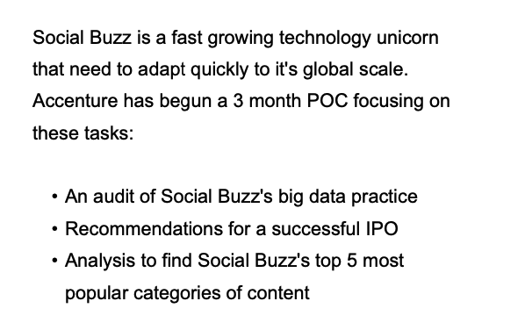
Project Recap

Slide 4

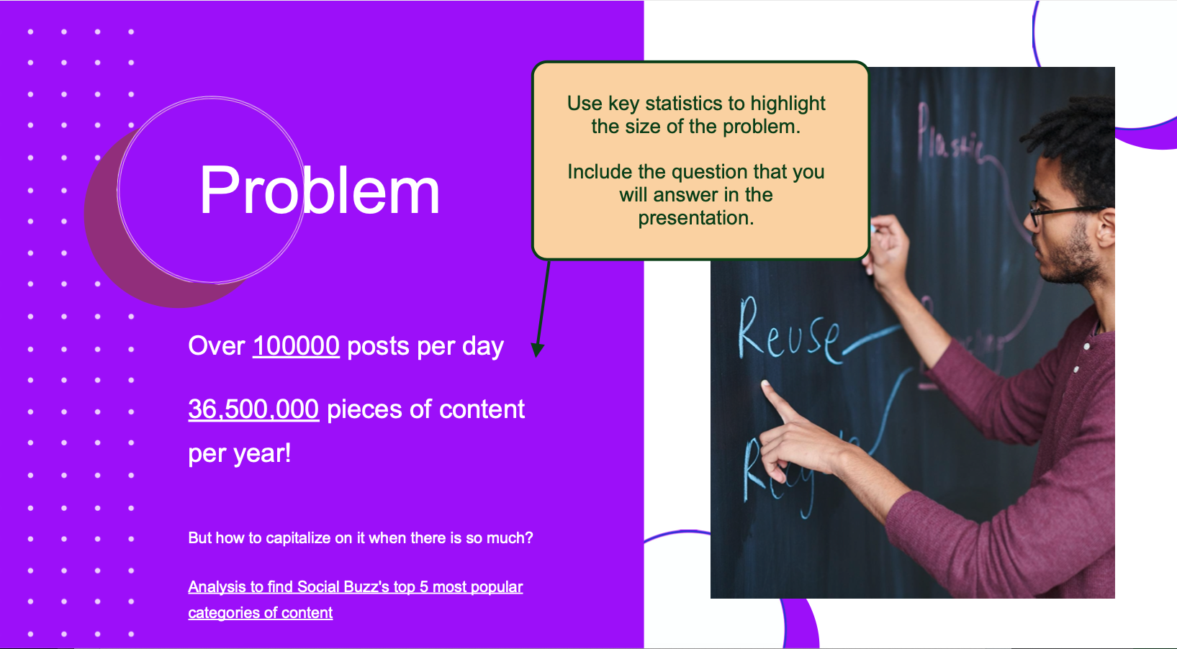
Problem

Slide 5



Abhishek Zine
(Data Analyst)
The Analytics team
Marcus Rompton (Senior Principle)
Andrew Fleming
(Chief Technical Architect)

Slide 6
Process
1 Data Understanding
2 Data Cleaning
3 Data Modelling
4 Data Analysis
5 Uncover Insights

Slide 7

Insights
Animal Category Has Scored Above 74 Thousands
Science Category Has Scored Above 71 Thousands
Healthy Eating Category Has Scored Above 69 Thousands

Slide 11

After Analyzing the data of Social Buzz, we found that the Category of animals, science, Healthy eating, technology and Foods are the top most Categories contributed in the Post.
Above mentioned categories are Most liked by the people by Evaluating the reaction type for Every category.
Summary

Slide 12
Thank you!
ANY QUESTIONS?

